Slide 1

FraudBuster
Saina Lajevardi

Slide 2

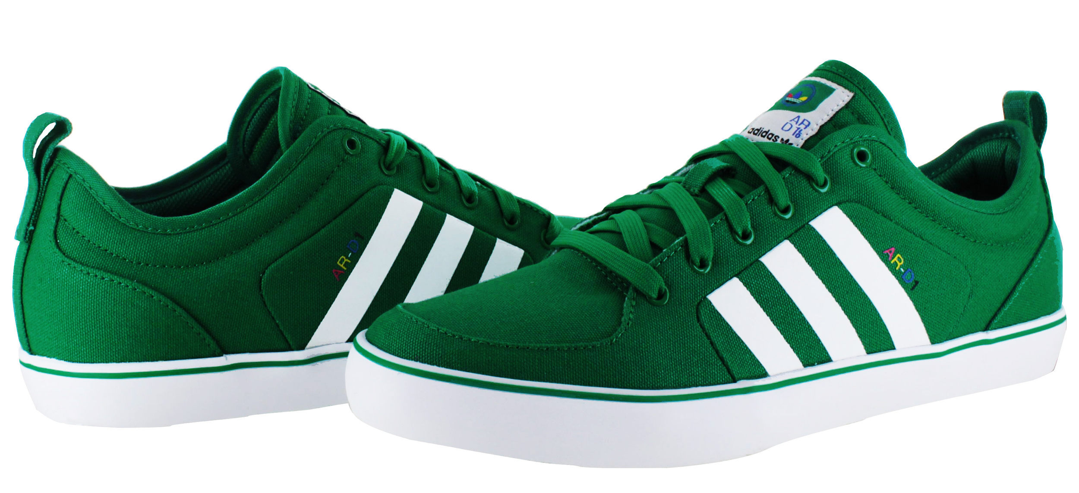

A sneaker marketplace app that guarantees authenticity
Notes:
GOAT acts as a middle man

Slide 3
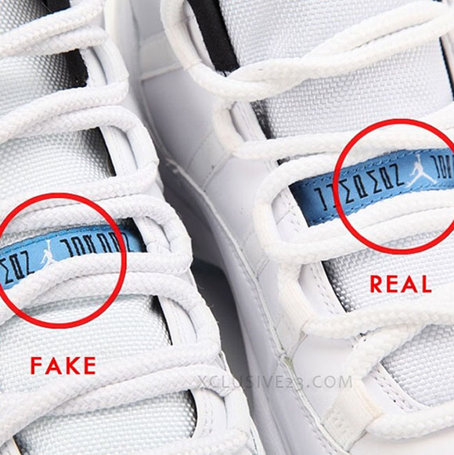
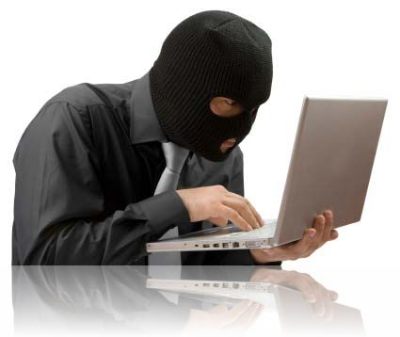
Fraud
fake sneakers
stolen identity

Slide 4
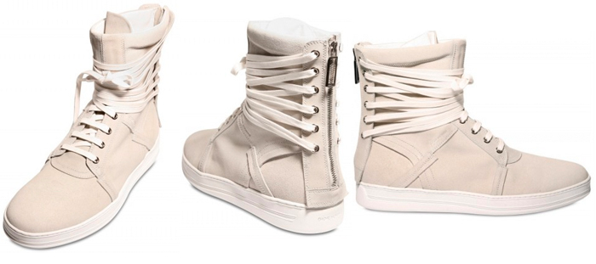
Current Fraud Detector
fraud detection from paypal and credit card by verifying manually
An automated fraud
detection to verify any order
Notes:
To integrate all other data that they are collecting in addition to credit into the fraud

Slide 5
FraudBuster
order
data
Feature Selection & Engineering
Data Exploration
(100K+ records)
sneaker data
user data
Random
Forest Classifier
Notes:
Here is how i decided to tackle this problem for goat
The most interesting part of this process is feature engineering, and making sure to not include features that are only coming after the order has been placed

Slide 6

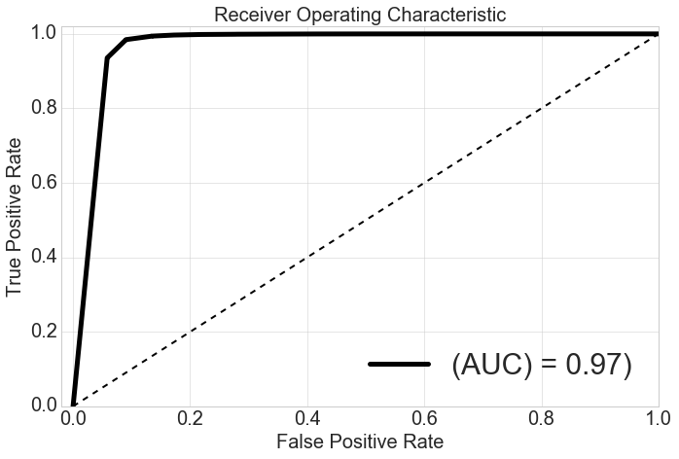
FraudBuster
Performance
with 0.6% false positive rate
recall | 0.87
precision | 0.85
F1_score | 0.86
Notes:
With threshold of 79%

Slide 7
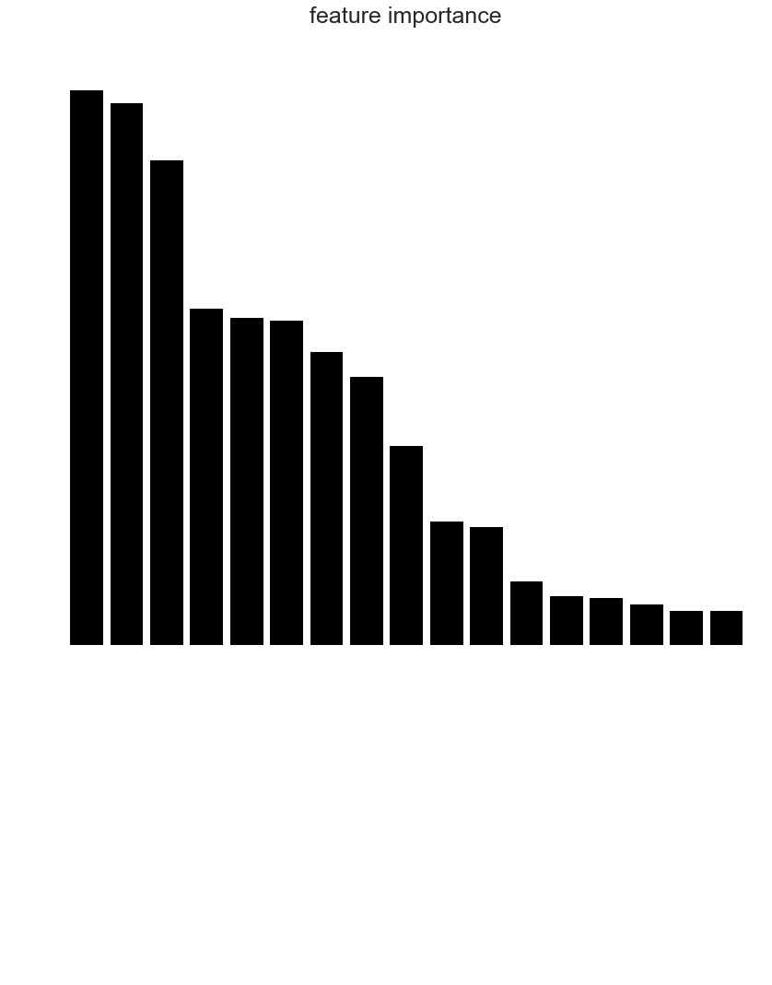
time since account
# owns
Feature
Importance
model popularity
# wants
device use freq.
zipcode difference
seller score
votes
IP difference
Notes:
Popularity of the brand
If the IP address has been used regularly
Zipcode similairty

Slide 8
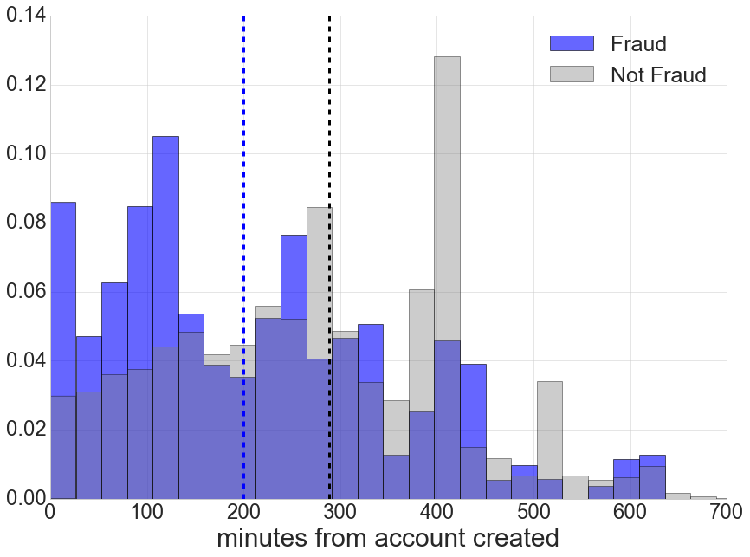
Additional Insight: Fraudsters act faster!

Slide 9
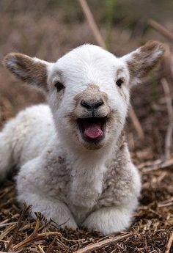
Increased recall:
52% to 87% (>1.67x)
Reduced false positive rate:
8.7 to 0.6% (14.5x)
FraudBuster Saves GOAT
> $250K annually
man hours

Slide 10


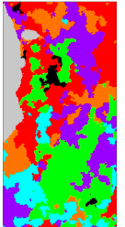
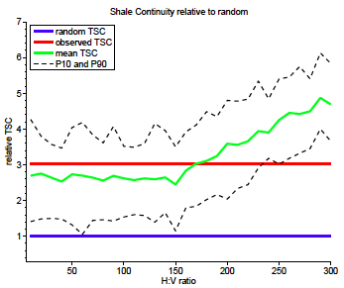
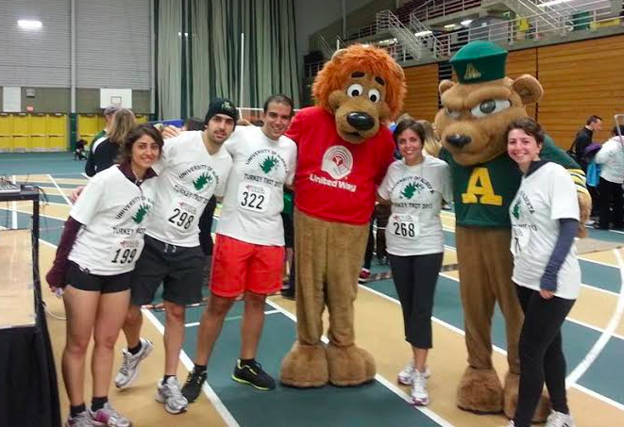

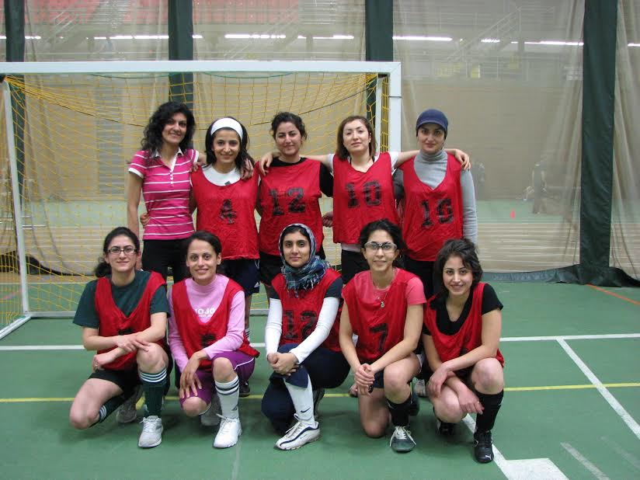
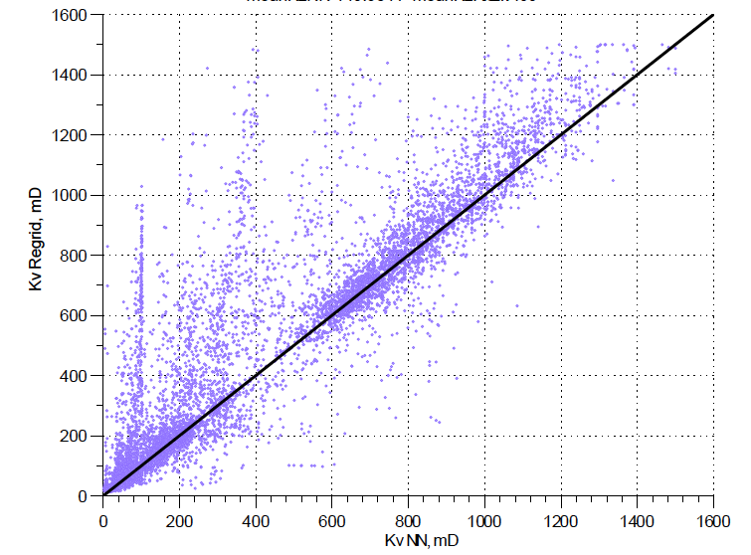
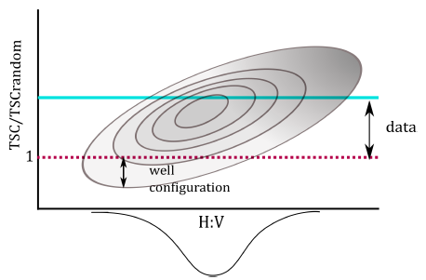
Saina Lajevardi
Geostatistics

Slide 11
Fraud
Seller sells fake sneakers
Buyer falsifies identity

